Slide 1
Chapter 3
Organizational Strategy, Information Systems, and Competitive Advantage
Notes:
Practice using Porter’s five forces model.
Understand how strategy determines decisions about everything, including IS.
Consider the risks of changes in technology to competitive strategy.
Help students understand how important it is to:
a. Know their employer’s competitive strategy.
b. Pay attention to that strategy in everything they do.

Slide 2
“We Can't Be Everything to Everybody.”
Known for providing security monitoring
Mateo wants to stay focused on big security contracts
Law enforcement agencies, search & rescue, federal government
Focus or diversify?
Good money in agricultural surveying, industrial inspecting, real estate videos, and wedding videos
Notes:
Use Falcon Security to:
Practice using Porter’s Five Forces Model.
Understand the application of competitive strategy.
Consider the risks of changes in the market to competitive strategy.
Understand major changes in company operations (3D manufacturing) create opportunity to change company mission.

Slide 3
Study Questions
Q1: How does organizational strategy determine information systems requirements?
Q2: What five forces determine industry structure?
Q3: What is competitive strategy?
Q4: How does competitive strategy determine value chain structure?
Q5: How do value chains determine business processes and information systems?
Q6: How do information systems provide competitive advantages?
How does the knowledge in this chapter help you?
Notes:
This chapter focuses on how information systems support competitive strategy and how IS can create competitive advantages.
The first part of the chapter, surveys how organizations analyze their industry, select a competitive strategy, and develop business processes. Then, extend that to show how to use it to structure information systems. Toward the end of the chapter is the discussion of how companies use information systems to gain a competitive advantage.

Slide 4
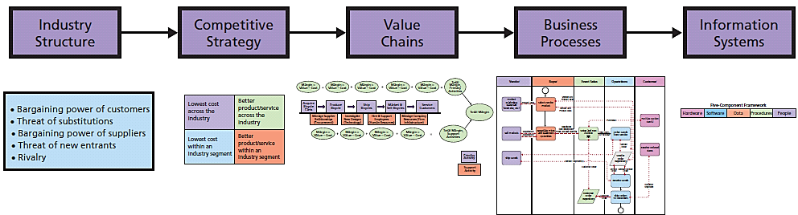
Q1: How Does Organizational Strategy Determine Information Systems Structure?
Strategy Determines Information Systems
Notes:
This figure summarizes a planning process used by many organizations.
Start with Porter's Five Forces to analyze industry structure.
Organizations examine the industry structure and determine a competitive strategy. That strategy determines value chains, which determines business processes. The structure of business processes determines the design of supporting information systems.

Slide 5
Q2: What Five Forces Determine Industry Structure?
Competitive Forces
• Competition from vendors who manufacture substitutes
• Competition from new competitors
• Competition from existing rivals
Bargaining Power Forces
• Bargaining power of suppliers
• Bargaining power of customers
Notes:
The intensity of each of the five forces determines the characteristics of the industry, how profitable it is, and how sustainable that profitability will be.

Slide 6
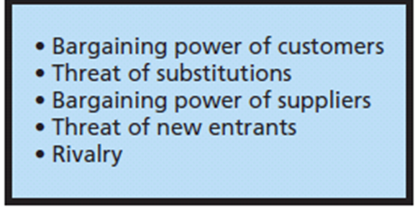
Porter’s Five Forces Model of Industry Structure

Slide 7
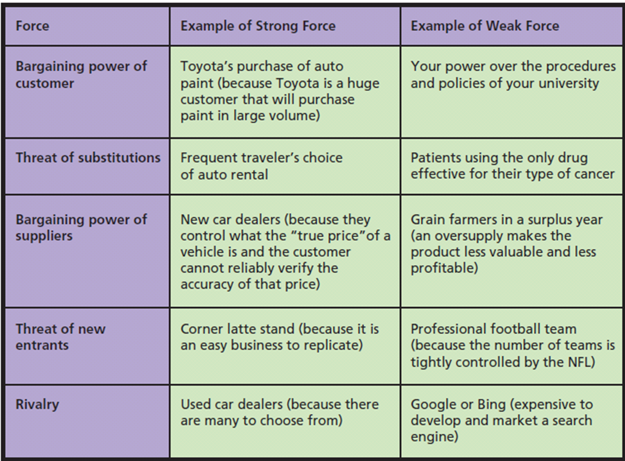
Examples of Five Forces
Notes:
To understand this model, consider the strong and weak examples for each of the forces. A good check on your understanding is to see if you can think of different forces of each category. Also, take a particular industry—say, auto repair—and consider how these five forces determine the competitive landscape of that industry.

Slide 8
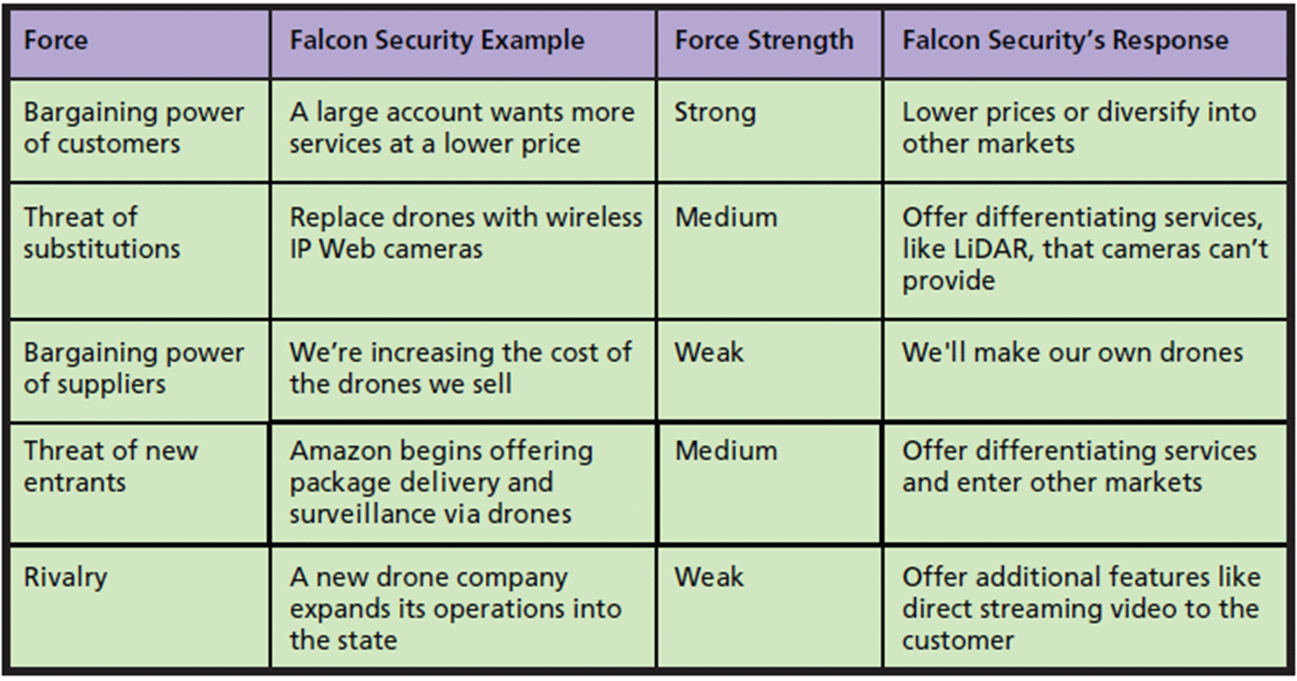
Five Forces at Falcon Security
Notes:
Analyze the opening vignette of this chapter, using the Five Forces model.
Organizations examine these five forces and determine how they intend to respond to them. That examination leads to competitive strategy.

Slide 9
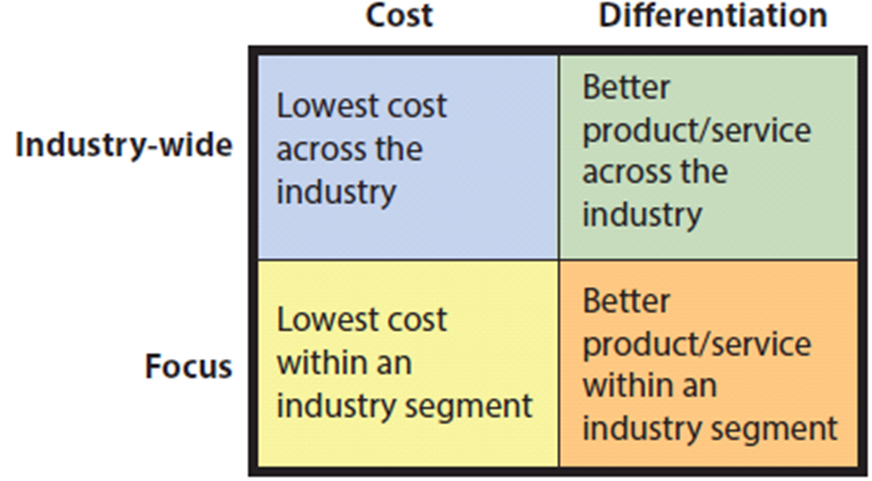
Q3: What Is Competitive Strategy?
Porter's Four Competitive Strategies
Notes:
To be effective, organization goals, objectives, culture, and activities must be consistent with the organization’s strategy.
This means, all information systems in organization must facilitate the organization’s competitive strategy.
Each of the three competitive forces concerns the danger of customers taking their business elsewhere.
Have students examine table to see why Falcon Security is exploring possibility of 3D printing.

Slide 10
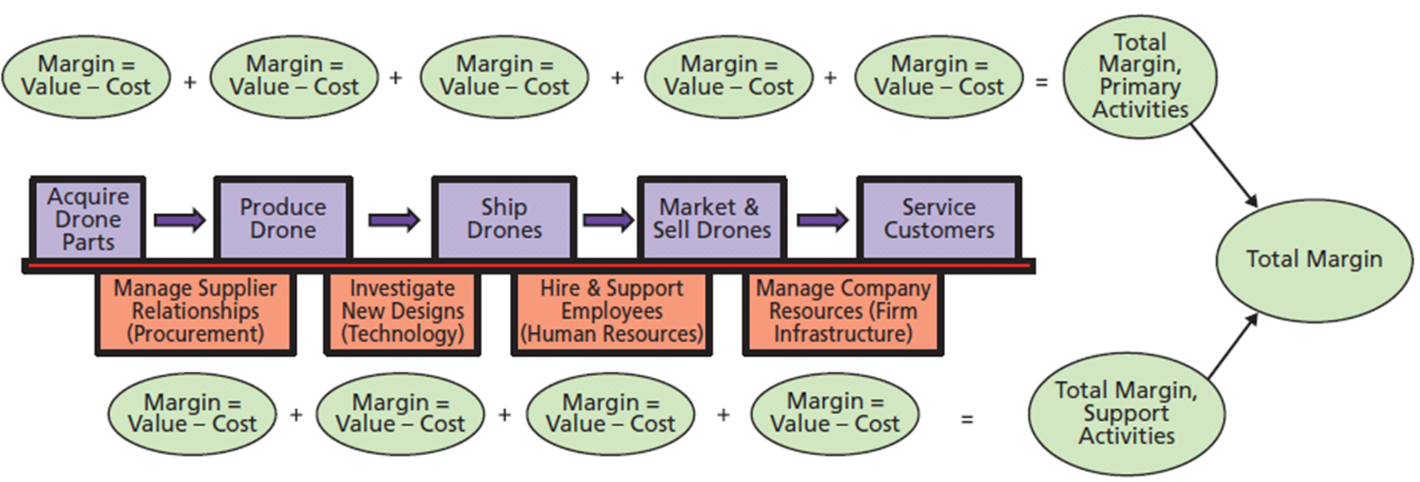
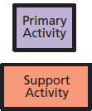
Q4: How Does Competitive Strategy Determine Value Chain Structure?
Linkages
Notes:
Medium-sized drone manufacturer’s value chain--network of value-creating activities
Difference between value an activity generates and its cost is called margin.
Linkages--interactions across value activities.

Slide 11
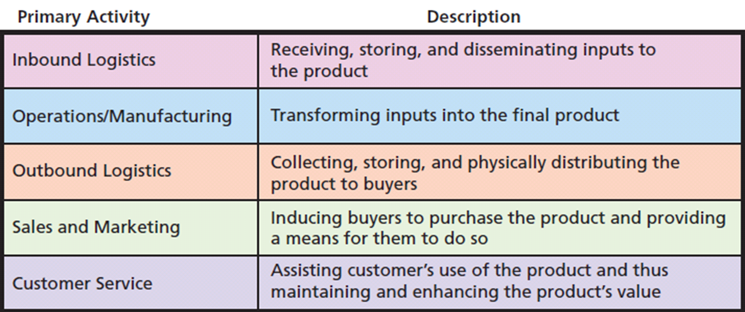
Task Descriptions for Primary Activities of the Value Chain
Notes:
Summary of primary activities of a generic value chain.

Slide 12
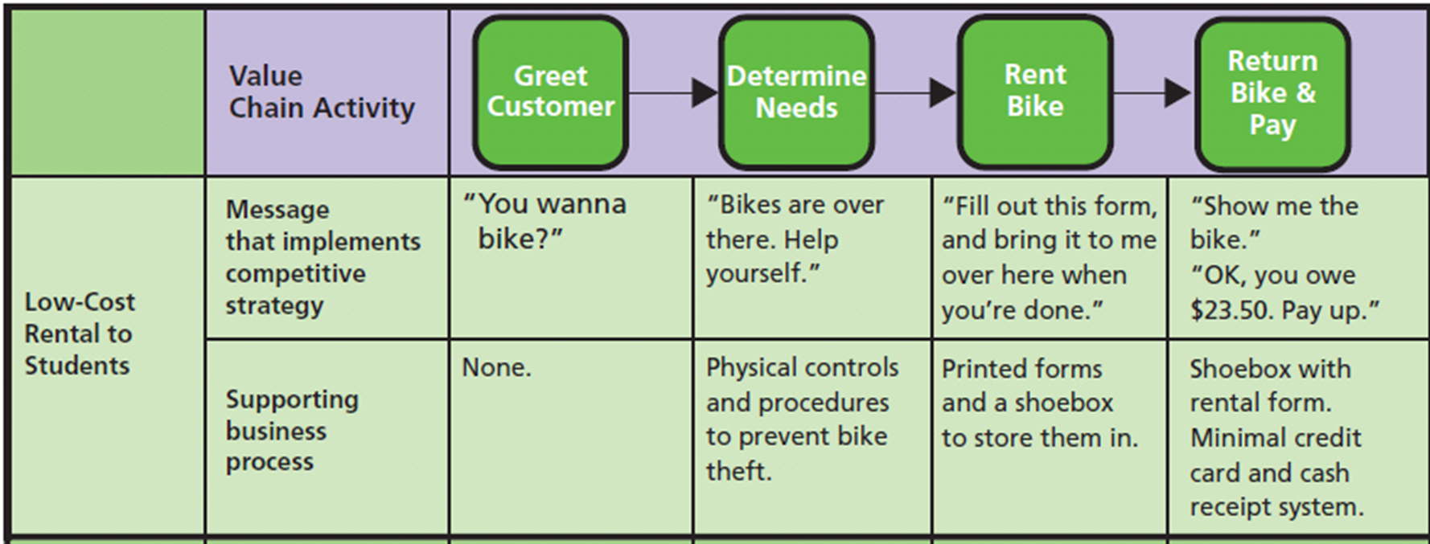
Q5: How Do Value Chains Determine Business Processes and Information Systems?
Notes:
Operations Value Chains for Bicycle Rental Companies

Slide 13
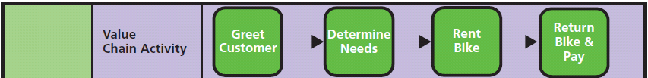
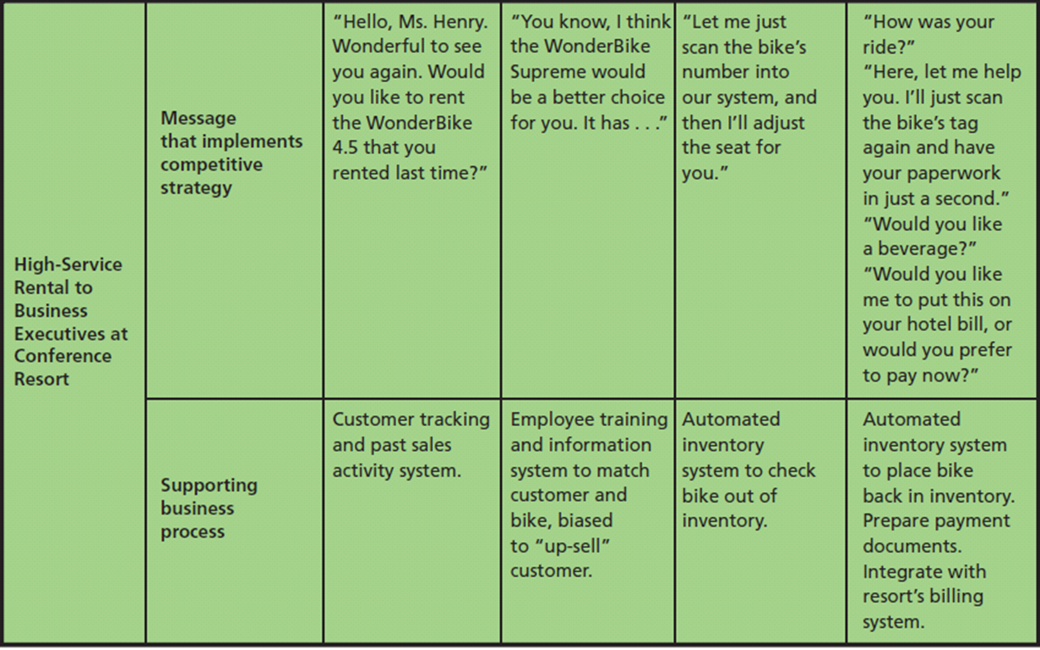
Q5: (cont’d)
Notes:
High-Cost Rental Operations Value Chain
Operationalized personalize customer service along with use of automation.

Slide 14
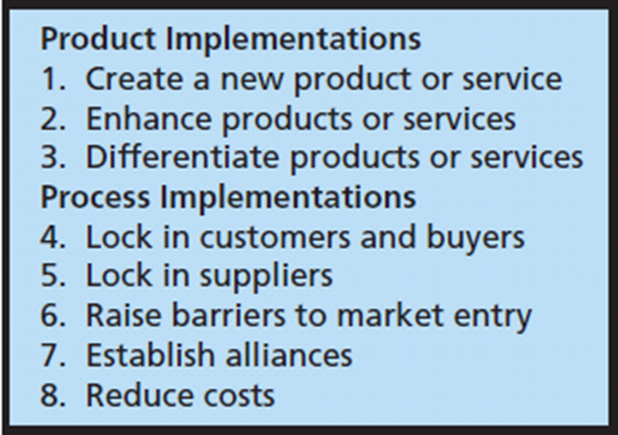
Q7: How Do Information Systems Provide Competitive Advantages?
Principles of Competitive
Advantage
Notes:
Some of these competitive techniques are created via products and services, and some by development of business processes.

Slide 15
How Does an Actual Company Use IS to Create Competitive Advantages? (cont'd)
Maintains customer account data
IS collects information for ABC (adds value)
IS saves customers time by automatically filling in part of form (adds value for customer)
Package & information delivery system
IS helps customer to select delivery address and generate shipping labels
What value does shipper get?

Slide 16
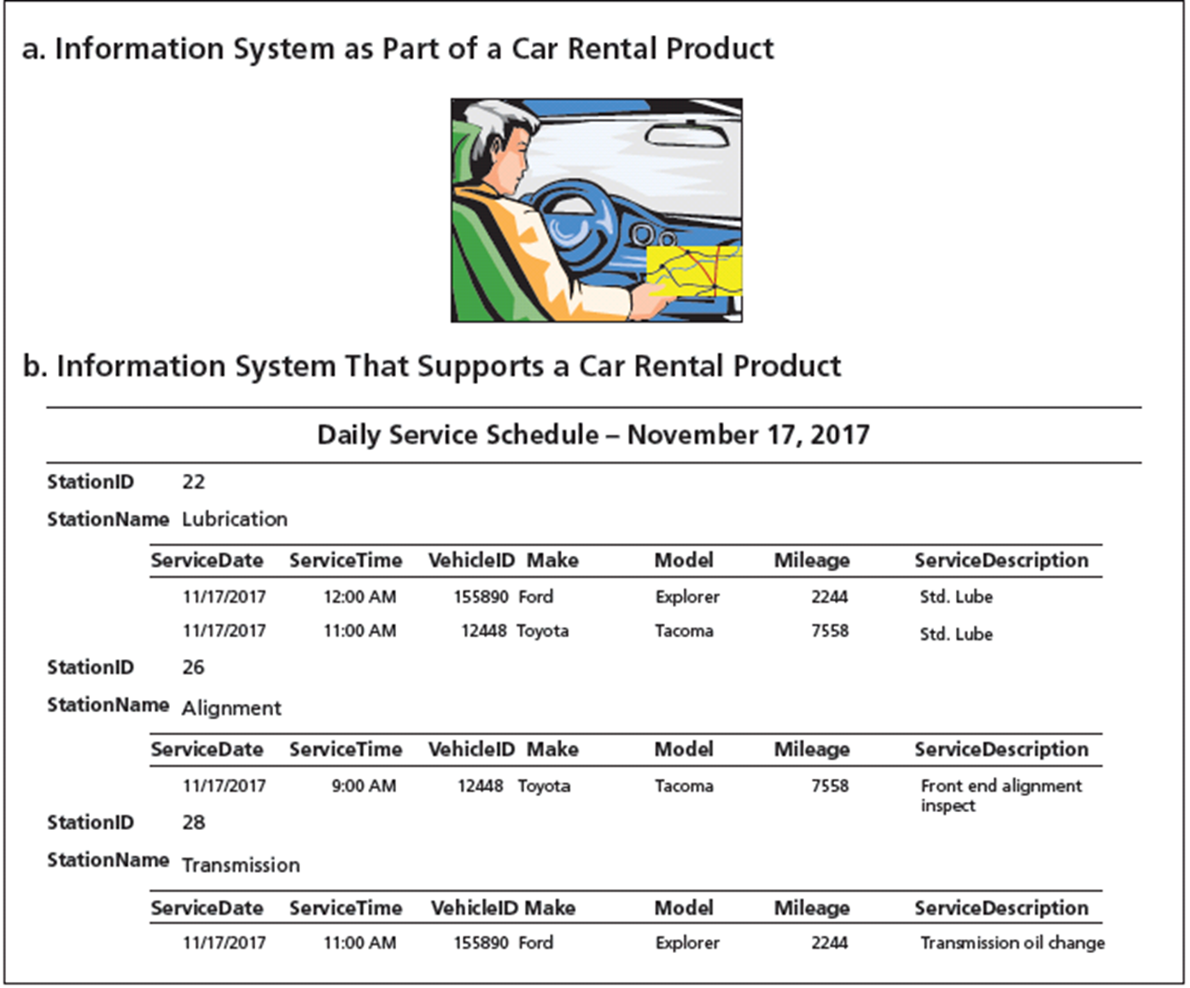
Two Roles for Information Systems Regarding Products

Slide 17
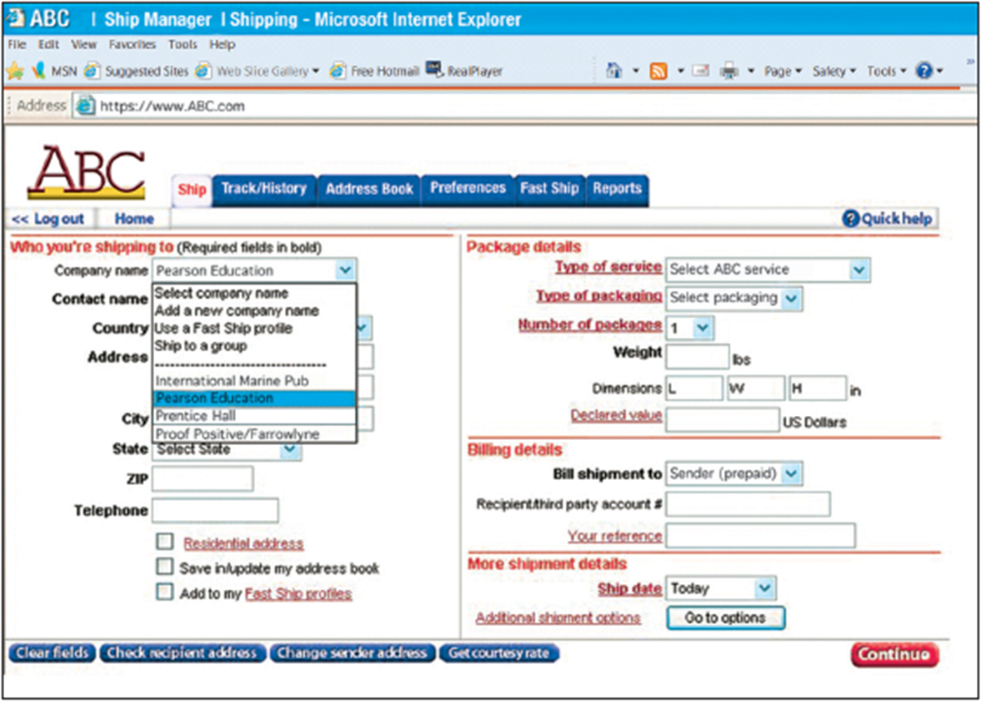
Web Page to Select a Contact from the Customer’s Records
Notes:
Shows a Web form that an ABC customer is using to schedule a shipment. When the ABC system creates the form, it fills the Company name dropdown list with the names of companies that the customer has shipped to in the past.
This information system enhances an existing service because it eases the effort of creating a shipment to the customer while reducing errors. The information system
also helps to differentiate the ABC package delivery service from competitors

Slide 18
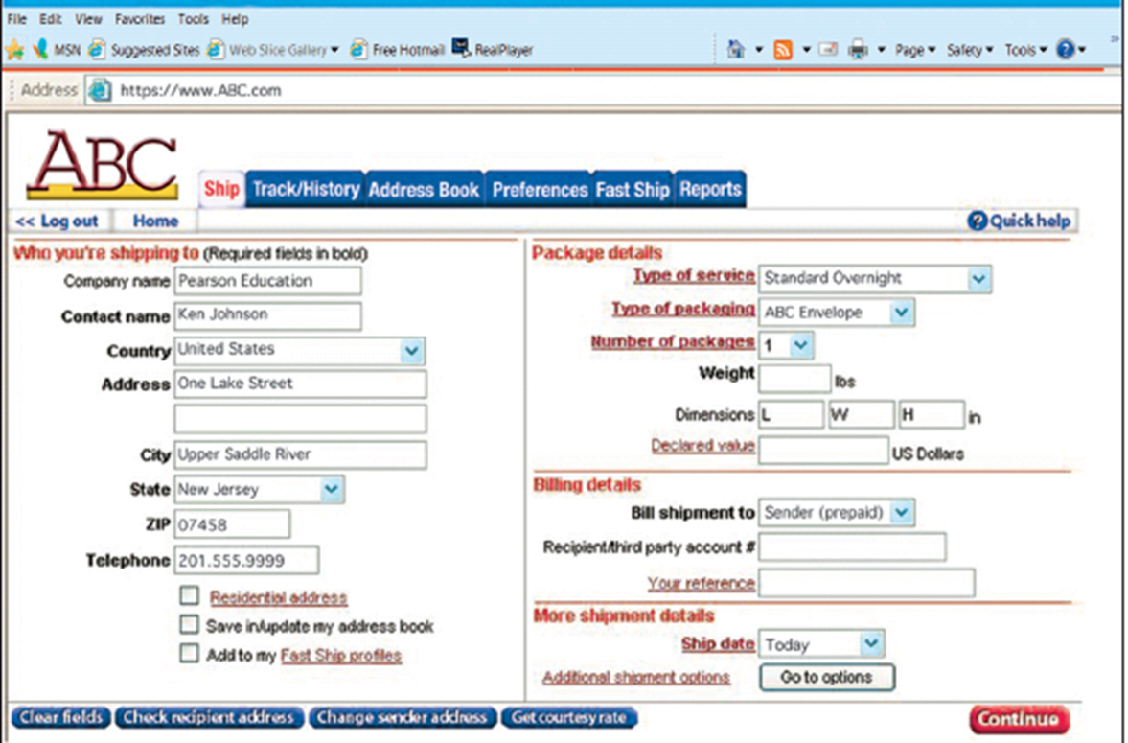
ABC Web Page to Select a Contact from Customer’s Records
Notes:
When the user clicks Company name, the underlying ABC information system reads customer’s contact data from a database. Data consist of names, addresses, and phone numbers of recipients from past shipments. User then selects a Contact name, and system inserts that contact’s address and other data into the form using data from the database

Slide 19
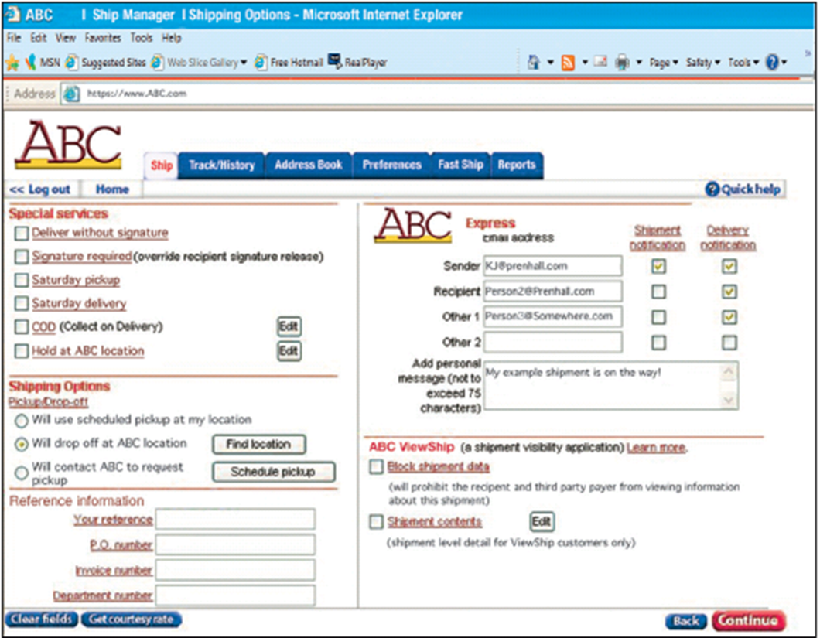
Web Page to Specify Email Notification
Notes:
On right-hand side of form, the customer can request ABC send email messages to the sender (the customer), recipient, and others.
By adding this capability to shipment-scheduling system, ABC extended its product from a package-delivery service to a package- and information-delivery service.

Slide 20
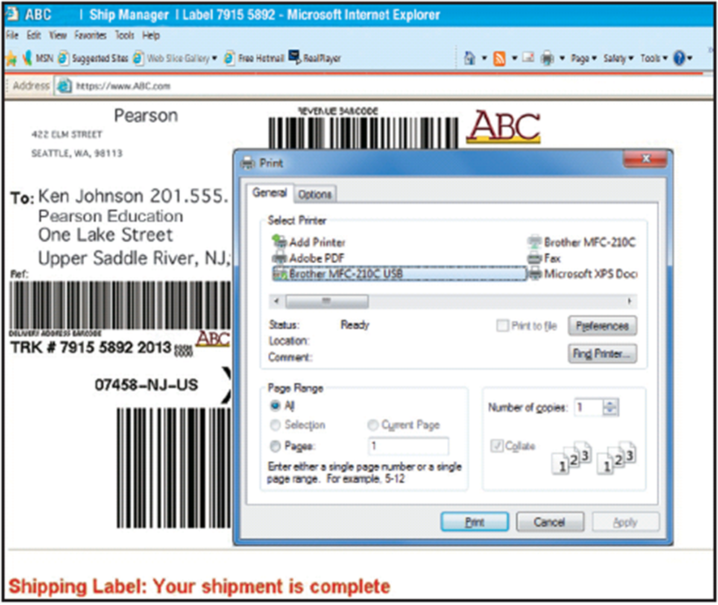
Web Page to Print Shipping Label
Notes:
By doing this, the company reduces errors in preparation of shipping labels, and causes customer to provide paper and ink for document printing.

Slide 21
How Does The Knowledge in This Chapter Help You?
Identify key points Falcon Security must address in deciding whether to expand its business beyond security services
Develop guidance for yourself about relationship between competitive strategy and information systems requirements
Summarize what you have learned from this example in a statement that you could make in a job interview

Slide 22
Yikes! Bikes!
You are the operations manager for Yikes! Bikes, a manufacturer of high-end mountain bicycles.
New owners plan to pursue lowest-cost vendor strategy by importing low-cost, lower quality bikes.
New owners not being honest with employees about cutting jobs.
Say you might be promoted to new general manager. Should you trust them?
Q: Are the owner’s actions illegal? Unethical?
Notes:
GOALS
Sensitize students to the fact that a competitive strategy is not just an academic topic. Changing competitive strategy has dramatic impacts on personnel and company culture.
Understand practical applications of business reports.
Explore ethical questions concerning communication about sensitive topics.
This guide illustrates the uncomfortable position many managers face when they possess knowledge that cannot be communicated to others in the company.
As a manager, you will sometimes have information that you are not supposed to communicate to employees. If an employee asks you directly about that information, you can either divulge it or lie. Which would you choose? What are the consequences of either choice?
Is there an alternative between inappropriately divulging information and lying? What is it? What disadvantages does that alternative have?
In general what are the consequences on the organization’s culture of moving from a differentiation strategy to a low-cost strategy?
In general what are the consequences on the organization’s culture of moving from a low-cost strategy to a differentiation strategy?

Slide 23
Guide: Your Personal Competitive Advantage
Who will be your competitors when you seek a job after graduating from college?
What will be your competitive advantage in the job market?
What can you do before you graduate to create a competitive advantage for your self?
Notes:
GOALS
Raise students’ awareness that they should be engaged in job planning/searching right now.
Show the application of the principles of competitive advantage to career planning.
Suggest innovative tasks for job searching.
Students seldom understand how their status as students gives them access to businesspeople that they will lose after they graduate.
Why should students talk with businesspeople and start building their networks now?
Encourage students to realize that they aren’t competing just with the students on their campus or their state. They are competing with students all over the world.

Slide 24
Using the Guide: Your Personal Competitive Advantage (cont'd)
How do these elements of competitive advantage apply to you personally?
Switching costs?
Differentiating products?
Creating barriers?
Establishing alliances?
Reducing costs, increasing revenues?

Slide 25
Active Review
Q1: How does organizational strategy determine information systems requirements?
Q2: What five forces determine industry structure?
Q3: What is competitive strategy?
Q4: How does competitive strategy determine value chain structure?
Q5: How do value chains determine business processes and information systems?
Q6: How do information systems provide competitive advantages?
How does the knowledge in this chapter help you?

Slide 26
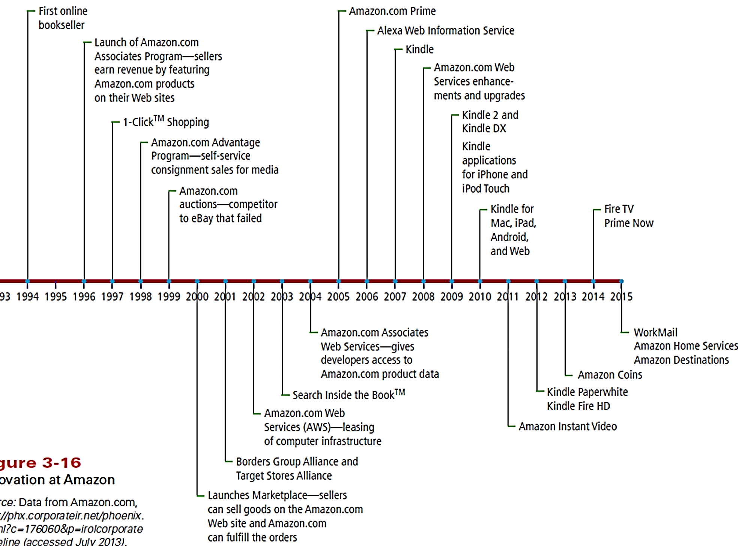
Case Study 3: The Amazon of Innovation
Notes:
Figure shows list of business innovations created by Amazon for online retailing. Began as an online bookstore in 1994, and added new product categories. In 2011, Amazon sold goods in 29 product categories.

Slide 27
Case Study 1: The Amazon of Innovation (cont'd)
Three categories of Amazon’s business lines:
Online retailing
Own inventory
Associates program
Consignment
Order fulfillment
Cloud services
Copyright © 2015 Pearson Education, Inc.
Notes:
Amazon built an enormous supporting infrastructure to ship 9 million items a day during the busy holiday season. Most of the year, Amazon.com has excess infrastructure capacity. Starting in 2000, Amazon began to lease some of that capacity to other companies and that led to the creation of cloud services.
You can ship your inventory to an Amazon warehouse and access Amazon’s information systems just as if they were yours.
Amazon Web Services allows organizations to lease time on computer equipment in very flexible ways. Organizations can expand and contract their computer resources within minutes.

Slide 28
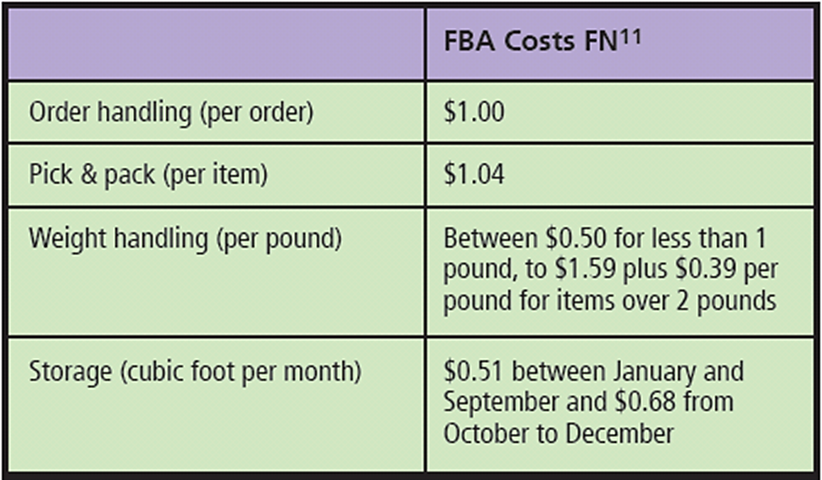
Costs for Fulfillment by Amazon by Type and Size of the Goods to Be Processed.
Notes:
The FBA fees for standard-size products as of February 2015 are shown in the table.
Using Web-standard technology (see Chapter 6), FBA customers’ order and payment data are directly linked to Amazon’s information systems.

Slide 29
Impact of FBA
Amazon provides customer service for order processing (handling returns, fixing erroneously packed orders, answering customer order queries, etc.).
Using Web-standard technology, FBA customers’ order and payment data directly linked to Amazon’s information systems.
Enables companies to outsource order fulfillment to Amazon, thus avoiding the cost of developing their own processes, facilities, and information systems for this purpose.

